Slide 1



PHARMACIST MANAGEMENT SYSTEM
Group name: panadol

Slide 2
GROUP MEMBER
Huỳnh Ngọc Anh Thư - ITCSIU21034
Phạm Nguyễn Đăng Khôi - ITCSIU21196
Trần Thế Phong - ITCSIU21215

Slide 3


TABLE OF CONTENTS
I. INTRODUCTION
II. Requirement Analysis
III. System and design
IV. TECHNIQUE
V. CONCLUSION AND FUTURE WORK
VI. DEMO and Q&A

Slide 4


I. Introduction
Purchasing medicine from local pharmacies
Preferring visiting pharmacies over hospitals for non-critical health concerns
Easily approaching and possessing medicine when needed
Solution
Web that can improve management for pharmacy owners and staff
Simplify day-to-day tasks, visually represent records
Effectively serving customers by storing user data for later uses

Slide 5
II. Requirement Analysis

Slide 6
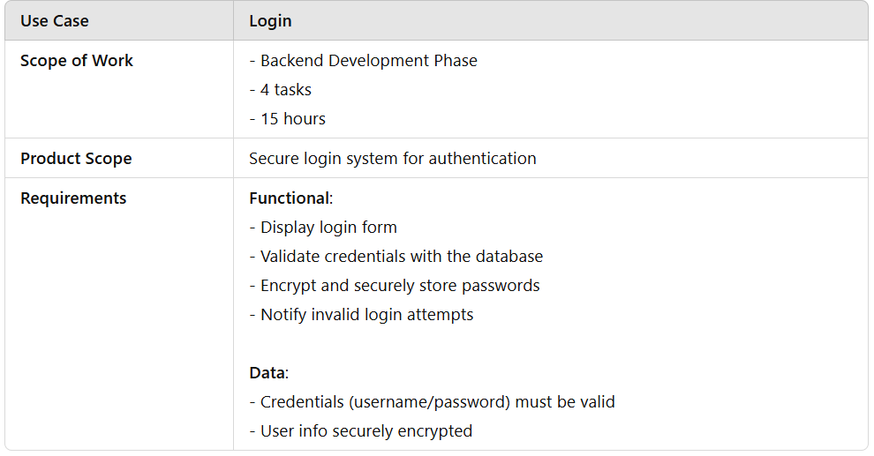

Functional Requirements

Slide 7
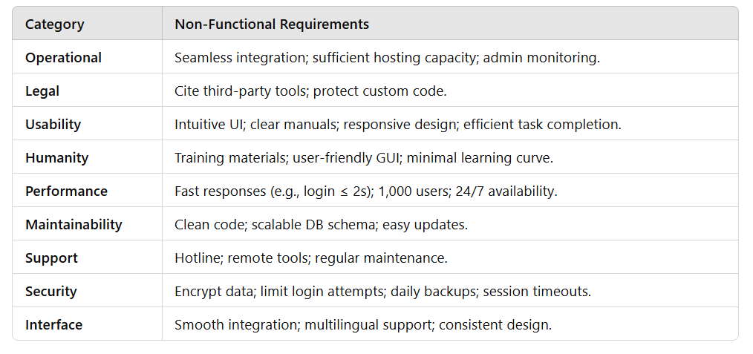
Non-Functional Requirements

Slide 8
III. System design

Slide 9


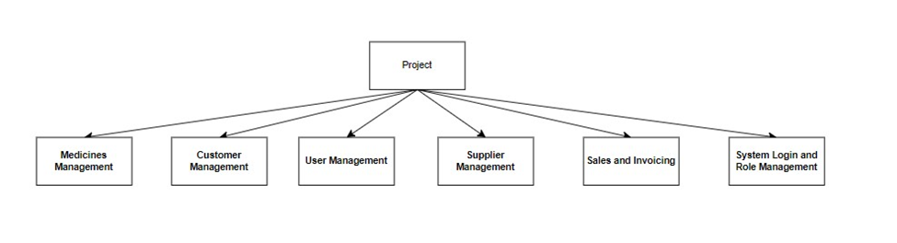

PROJECT STRUCTURE

Slide 10
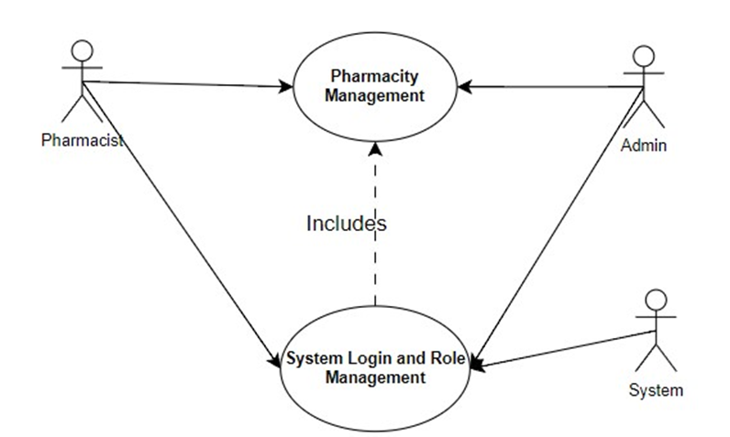
USE CASE DIAGRAM

Slide 11
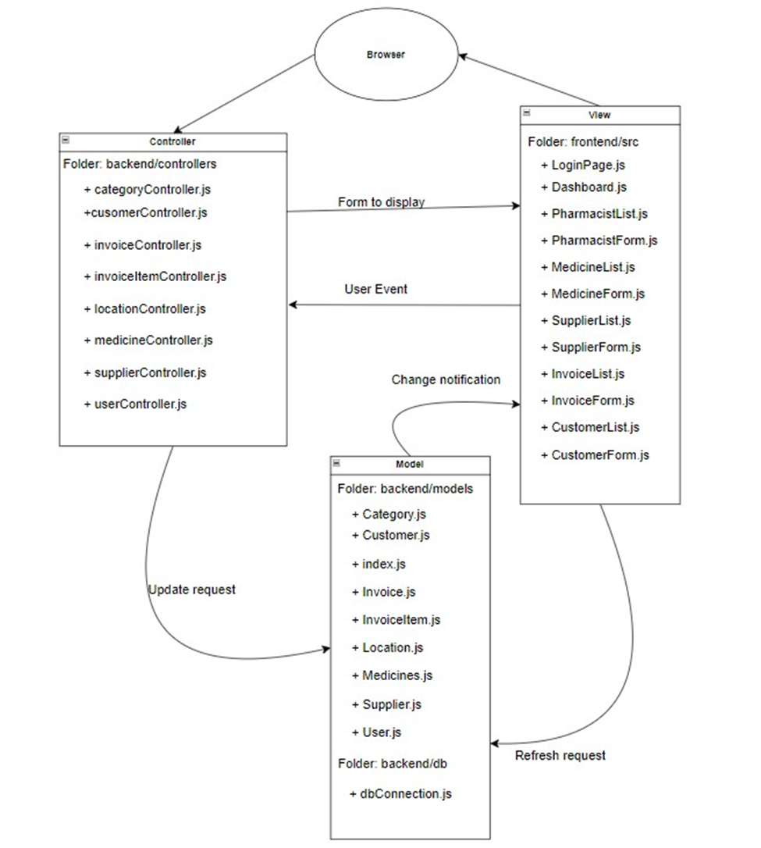
ARCHITECTURE MODEL

Slide 12
ENTITY RELATIONSHIP DIAGRAM

Slide 13
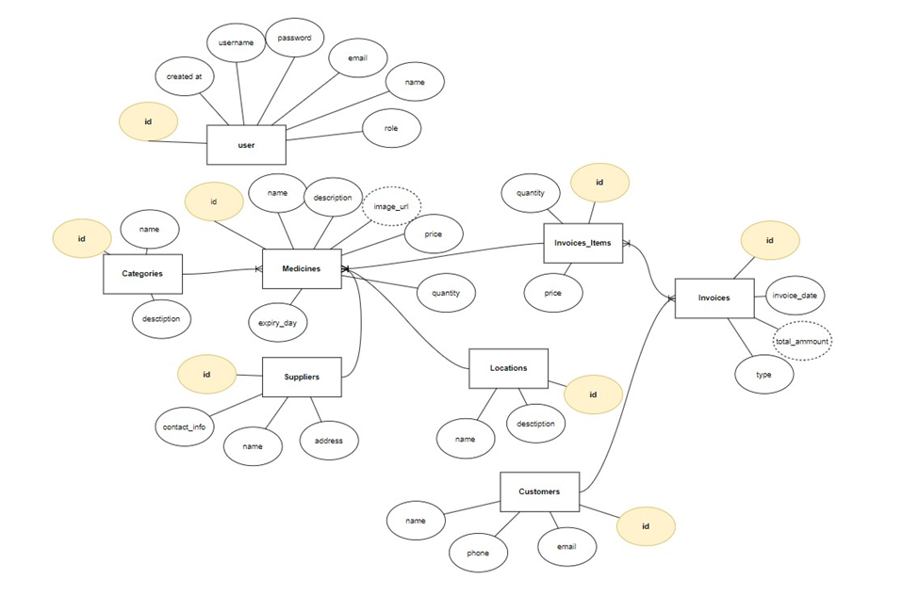

Slide 14
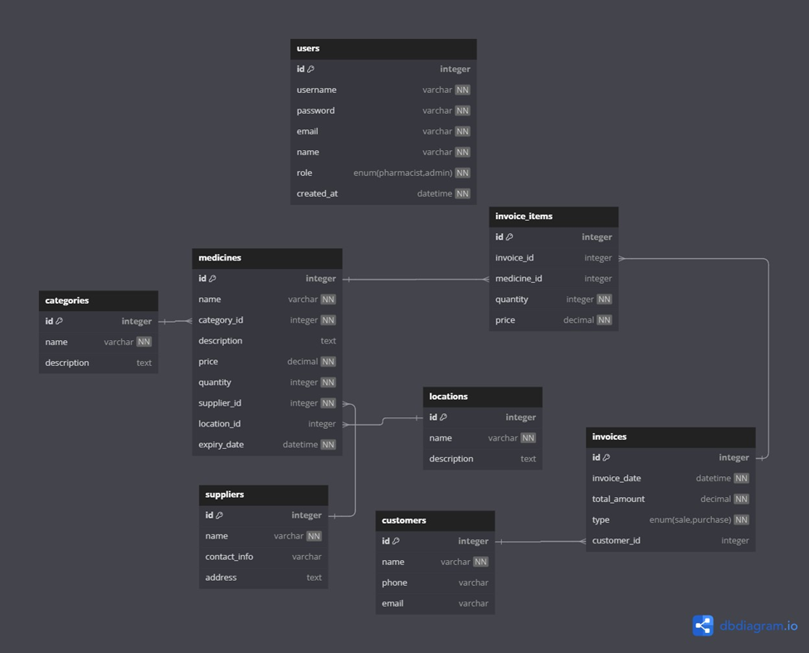
CLASS DIAGRAM

Slide 15
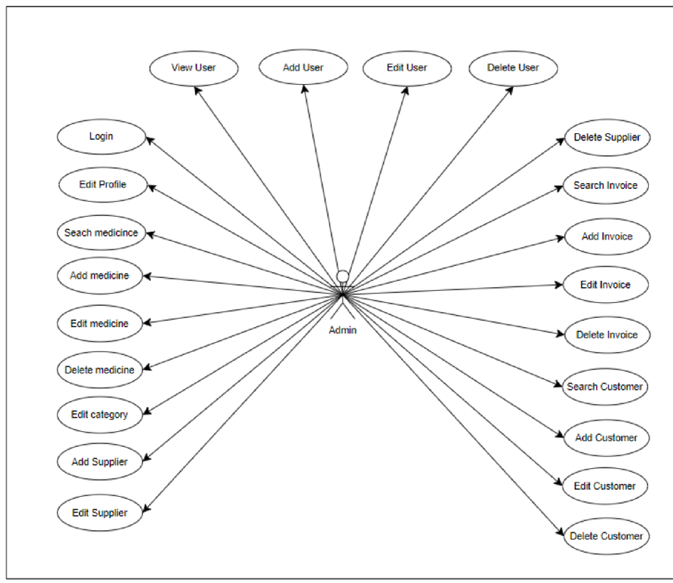
USER GOAL USE CASE: ADMIN

Slide 16
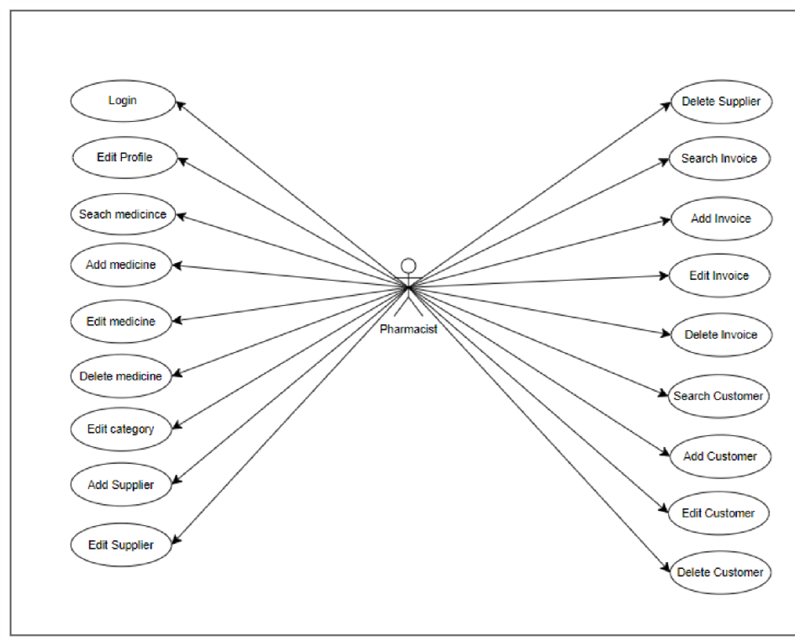
USER GOAL USE CASE: PHARMACIST

Slide 17
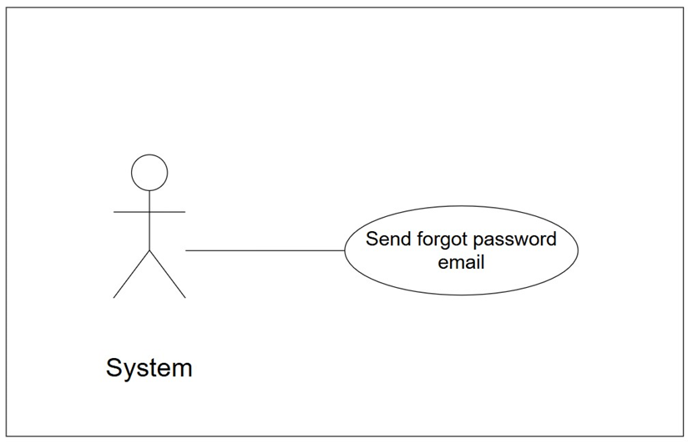
USER GOAL USE CASE: SYSTEM

Slide 18
IV. Technique

Slide 19





FRONTEND
HTML
CSS
JavaScript
ReactJS

Slide 20




BACKEND - DATABASE
ENVIRONMENT
JavaScript
Express

Slide 21



DEPLOYMENT
Frontend
Backend
Database
Netlify
Render
Railway

Slide 22


TESTING AND VERSION CONTROL
Github
Postman

Slide 23


V. Conclusion and future work

Slide 24

CONCLUSION
Improving Customer Service with Streamlined Processes
Optimizing Inventory and Sales Management
Enhancing Pharmacy Efficiency through Automation
Ensuring Accuracy and Reducing Manual Errors
A Modern Solution for Pharmacy Operational Challenges

Slide 25

FUTURE WORK
AI-Based Inventory Forecasting
Online Customer Portal
Multi-Pharmacy Support
Enhanced Security Features

Slide 26

VI. Demo and Q&A

